Slide 1


Deep Boltzmann Machines: Architecture, Learning Mechanism and Applications
SIMATS ENGINEERING Saveetha Institute of Medical and Technical Sciences Chennai-602105.
MLA0408 – Deep Learning
PRESENTATION BY:
k Sreelatha(192425248)

Slide 2
Introduction to DBM
Deep Boltzmann Machine is a generative neural network used to learn complex patterns and representations from data.
It is an unsupervised learning model.
It contains multiple hidden layers.
It learns hierarchical features.
It uses undirected connections between adjacent layers.
It can model complex probability distributions.
Example: Image → Basic features → Shapes → Objects

Slide 3
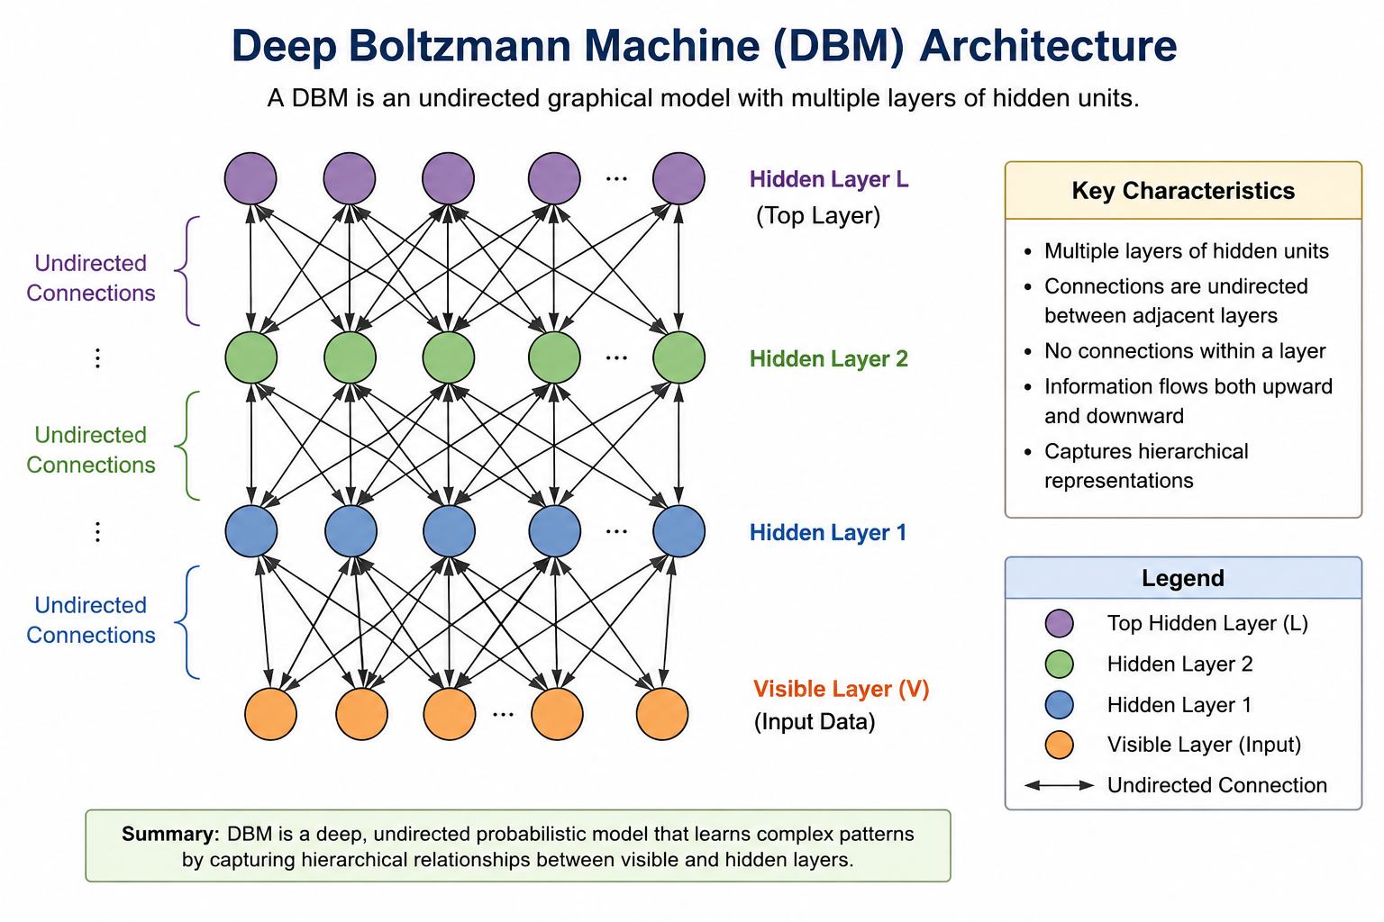

Slide 4
Interaction Between Layers
DBM layers interact through symmetric connections.
Visible layer sends information to H1.
H1 communicates with both visible layer and H2.
H2 provides higher-level information back to H1.
Information can flow upward and downward.
Each layer learns different levels of representation.
Example:
Pixels → Edges → Shapes → Object
This allows DBM to learn complex features automatically.

Slide 5
Learning Mechanism
DBM learns using energy-based probabilistic learning.
Main steps:
Input data is given to the visible layer.
Hidden layers calculate probability distributions.
Hidden units are activated probabilistically.
The model reconstructs the input.
The difference between data and model distribution is calculated.
Weights are updated.
The process is repeated until the model learns a good representation.
Key concept: Lower energy = more likely configuration.

Slide 6
Advantages of DBM
Learns hierarchical representations.
Handles complex data distributions.
Useful for unsupervised feature learning.
Can capture high-level relationships.
Provides powerful probabilistic modeling.

Slide 7
Practical Application: Image Recognition
Application: Handwritten Digit Recognition
DBM can learn features from handwritten digit images.
Digit Image
↓
Visible Layer
↓
Hidden Layer 1
↓
Edges and simple patterns
↓
Hidden Layer 2
↓
Shapes and digit patterns
↓
Classification
Why DBM is suitable?
Images contain complex patterns.
DBM automatically learns hierarchical features.
It can learn without requiring large amounts of labeled data.
Learned representations can be used for classification.

Slide 8
Conclusion
DBM is a deep probabilistic generative model.
It contains multiple hidden layers.
It uses undirected connections between adjacent layers.
It learns hierarchical representations.
It is more powerful than a conventional shallow Boltzmann Machine.
DBM is useful for image recognition, recommendation systems, and feature learning.

